Slide 1


ECEN 403
Final Presentation
Implementing a GRU based network to detect stock prices on FPGA
Sean Kwatra
Xavier Fisher
Kevin Sipple
Sponsor: Sambandh Dhal

Slide 2
Executive summary
Problem statement:
Stock analyzing software is extremely expensive and complicated, not welcoming to inexperienced traders
Prevents retail traders from capitalizing on new market trends and hard to access data
Our System will:
Connect to the internet to obtain current and past data on stocks
Use a GRU to analyze the data collected to predict the future of the stock
Our Estimated System Cost:
$1,600

Slide 3
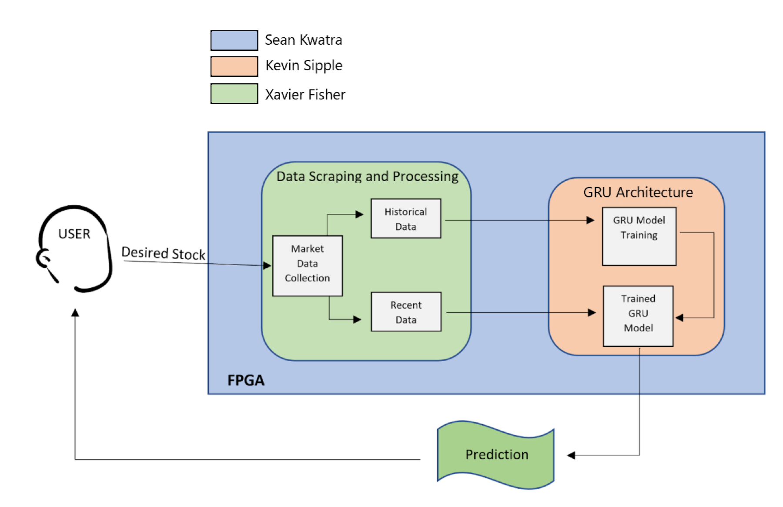
System Block Diagram

Slide 4
FPGA Subsystem
Sean Kwatra

Slide 5
FPGA’s Problem Overview
Main Problem: How to allow an FPGA to run advanced python scripts with specialized machine learning libraries.
First using petalinux I built a boot image and configured it to use a root file system allowing the linux kernel to save data onto an ext4 partition of an micro SD card.
Next I configured petalinux to include python version 3 and pip to allow the linux kernel to add any necessary python libraries.
Finally I transferred the built boot image and root file system to a micro SD card to allow the FPGA board to boot from it.

Slide 6
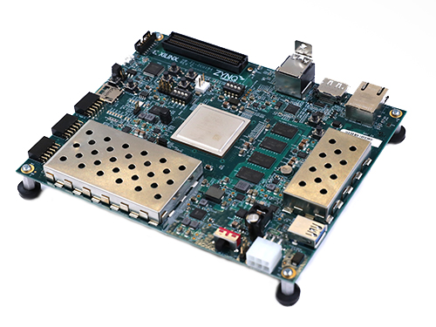
FPGA’s Accomplishments
Successfully created and built a custom hardware platform for the Zybo Z7-10.
Used the custom hardware platform to build a custom petalinux project for the Z7.
Booted both Ubuntu and Debian on the Z7.
Using the same process as the Z7 to create a petalinux project for the ZCU104 FPGA.

Slide 7
FPGA’s Execution Status
 | 2/28/22 | 3/7/22 | 3/14/22 | 3/21/22 | 3/28/22 | 4/4/22 | 4/11/22 | 4/18/22 | 4/25/22 | ECEN 404
Fully install and test the embedded Linux
Start Designing case and install cooling system
Fully design and print case and mount onto FPGA
Not Started
Completed
In Progress
Delayed

Slide 8
FPGA’s Remaining Tasks
During 403:
Boot a linux kernel on the ZCU104 with built boot image.
Install specialized ML python libraries and test using test scripts.
During 404:
Start training the GRU on the board itself.
Implement a cooling system to reduce the risk of overheating and damaging the FPGA.
Start designing case for the FPGA.

Slide 9
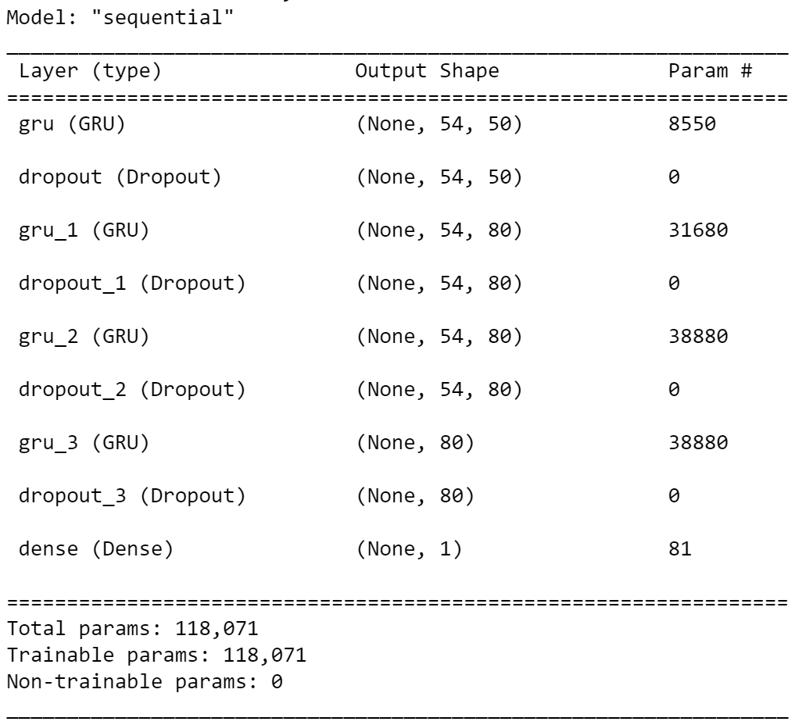
GRU Architecture Subsystem
Kevin Sipple

Slide 10
GRU Architecture Subsystem Overview
Time invested since last update: ~27 Hrs
Machine Learning:
Gated Recurrent Unit (GRU)
Recurrent Neural Network (RNN)
Training using ~3000 data points
Visualize predictions
Subsystem Difficulties:
Adjusting GRU architecture appropriately
Limited Training Data available per stock
Over-fitting Concern
Constructing data sets and proper scaling factors (GRU)
(size, timesteps, attributes)
(soft difficulty) Waiting for results to make adjustments

Slide 11
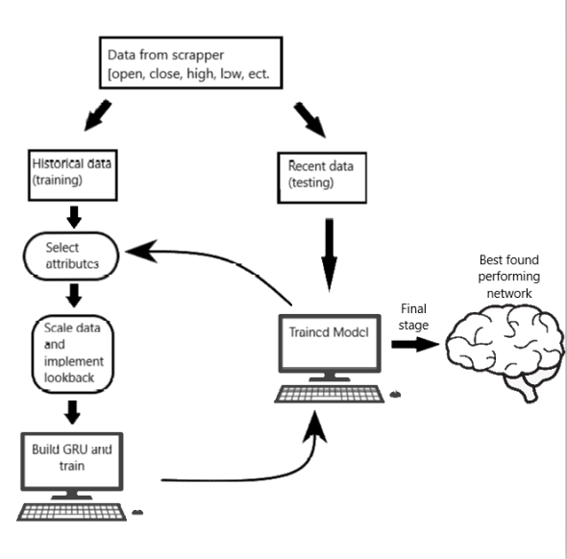
GRU Arch. Flow Chart

Slide 12
GRU Architecture’s Accomplishments
Two key ways to test the accuracy
Method to alter multiple array characteristics
this involves properly clearing and building models
A variable look back system
GRU performance has reached a 56% accuracy
GRU Arch. Execution Status
GRU Arch. Execution | 1/24 | 1/31 | 2/7 | 2/14 | 2/21 | 2/28 | 3/7 | 3/14 | 3/21 | 3/28 | 4/4 | 4/11 | 4/18 | 4/25
Download Keras GRU library and generate a small test network
Generate multidimensional arrays of different data combinations |  |  |  |  |  |  |  |  |  |  |  |  |  |  | Not Started
Test different layer numbers and neuron numbers and produce visualizing plots |  |  |  |  |  |  |  |  |  |  |  |  |  |  | Completed
Implement an accuracy metric |  |  |  |  |  |  |  |  |  |  |  |  |  |  | In Progress
Finalize the data characteristics array |  |  |  |  |  |  |  |  |  |  |  |  |  |  | Delayed
Create system to vary arrays to find best characteristics |  |  |  |  |  |  |  |  |  |  |  |  |  |  | Canceled
Test performance on FPGA and compatibility

Slide 13
GRU Arch. Validation
Arrays are split properly based upon year of data and NaN rows are removed
Model is properly cleared between tests
Look back system produces arrays of specified structure and is verified in program:
( size, lookback, attributes )
Directional Accuracy and RMSE functions output confirmed

Slide 14
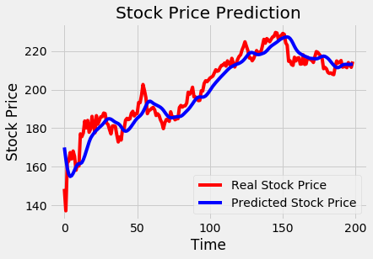
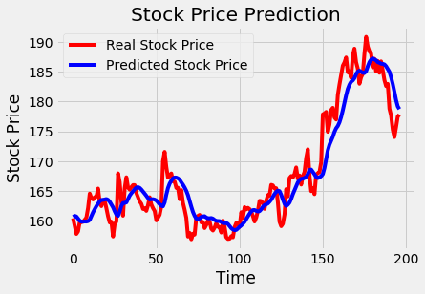
GRU Architecture Results/Samples
The root mean squared error is 6.12719
The directional accuracy is 55.56
Charact. [High, Low]
2020
The root mean squared error is 3.128237
The directional accuracy is 46.94
Charact. [High, Low, Open]
2018

Slide 15
GRU Arch. Remaining Tasks
403:
Test performance on FPGA (delayed)
Finish system to select best fitting array characteristics
Include new characteristics available from the scrapper
[insider and inflation]
Further Validate proper scaling of arrays
Time permitting, test a new optimizer
404:
Test performance on FPGA contin.
Clean code to make minimal array/tensor operations
Compare performance of different GRU archs.
Eric: Implement an LSTM version

Slide 16
Data Scraping Subsystem
Xavier Fisher

Slide 17
Data Scraping Subsystem
Main purpose is to gather data to feed into machine learning network
Data split into three main subcategories; main, secondary, and external
Main data: Open, close, low, high, volume.
Secondary data: Insider trades, EPS
External data: Google trends, market/doomsday sentiment

Slide 18
Data Scraping Accomplishments
Accomplishments in 403 | Remaining tasks | Key design activities for 404
Designed programs to gather Open/close/low/high prices, volume, insider trades, EPS, and google trends data and append them to a CSV file Integrated all separate modules into one program for simplicity and ease of use | Obtaining sentimental data about any particular stock Further optimize and debug programs | Integrate a robustly designed user interface interconnectivity Perhaps change, add, or remove different data types

Slide 19
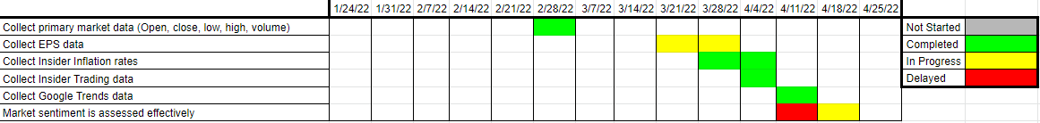

Data Scraping subsystem execution and validation status
Validation test | Testing method | Met
Handles empty datasets without interrupting program | Give inputs with known empty datasets
Correct data aligned with corresponding date in CSV | Visually inspect CSV file and compare to website data
No duplicate data appended to CSV | Visually inspect CSV file and ensure there are no duplication anomalies

Slide 20
Thank you!
Questions?

Slide 21
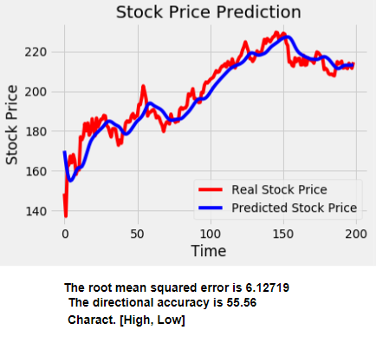
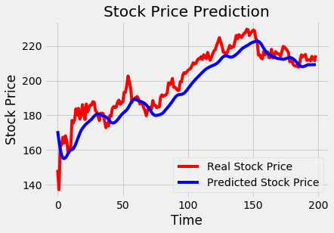
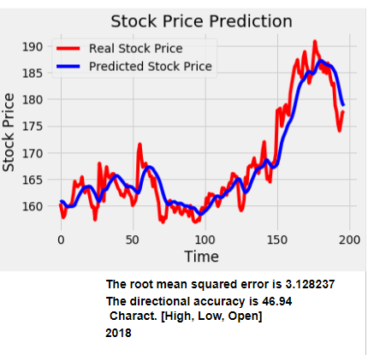
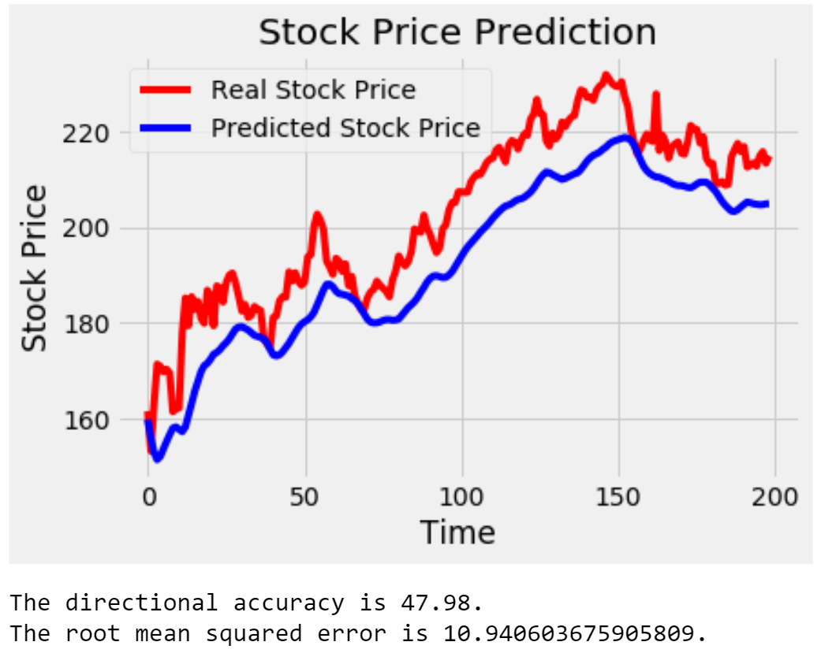
GRU results extra slide
The root mean squared error is 7.95503
The directional accuracy is 55.05
Charact. [High, Low, Open, EPS, Day]
The model was changed between these

